Slide 1

JS Pudding
Tetali Chaitanya

Slide 2

I represent World-Peace and...

Slide 3


Me: Loved everywhere? Found everywhere?
And does great things for Humans
World:

Slide 4
Me:
Why to meet you JS?? Where are you even used??

Slide 5
JS: As said, I’m everywhere like air. There you go..
Web development: RxJS, Socket.IO, D3.js, Riot.js .,etc
Hybrid App Development: Cordova, Ionic .,etc
IOT Development: Johnny-Five, Cylon.js, Node-Red, Jerryscript .,etc
Desktop Application Development: Electron, NW.js, AppJS .,etc
Server-side implementations: Node.js, jaggery.js, SilkJS .,etc
JS engines used in : CouchDB, MongoDB, Whitebeam., etc

Slide 6
JS: And I’m not done yet!!!..
General Frameworks : jQuery, Dojo Toolkit, Underscore.js., etc
Me: Wooww, didn’t see that coming.. ..
.
Tell me more about Electron and Node..?
MV* : Angular.js, Backbone.js, Knockout.js, Meteor., etc
Animation Frameworks : GSAP, Velocity.js, TweenJS, Favico.js., etc
Game Engines : Phaser, Cocos2d-HTML5, ImpactJS, MelonJS., etc
Virtual Reality : WebVR, A-frame., etc
Libraries and frameworks : React, Vue.js, Dust.js., etc

Slide 7


JS: Electron is for Developing Desktop applications
Desktop application Skype is built on it, and so is Github Desktop

Slide 8
JS: Enough of enquiries!!, Before knowing about Node, understand me first.
Me: Okay, but what features you have??
I’m Created by Netscape in 1995 as an extension of HTML for Netscape Navigator 2.0, I had as my main function the manipulation of HTML documents and form validation back then.
Now my standard is ECMAScript. As of 2012, all modern browsers fully support ECMAScript 5.1.

Slide 9
JS: Look at my Coding Benefits:
OBJECT ORIENTED
ANONYMOUS FUNCTIONS
Me: That’s a lot of features!! Acha tell me, What stuff that you do in browser, got you this fame??
LOOSE TYPING
SCOPING AND HOISTING
CLOSURE FUNCTION
FUNCTION BINDING
STRICT MODE
IMMEDIATELY-INVOKED FUNCTION EXPRESSION (IIFE)
Etc etc etc

Slide 10
JS: I’m the Avengers team for Browser.. !
That’s really impressive.. And I think I’m starting to like you, but before that, Tell me more about your relationship with Browser.
DOM and it’s manipulation: CRUD operations on HTML and CSS
Events: Mouse-clicks, animations, Keyboard strikes .,etc
Requests to server: AJAX , COMET with sides of long/short-polling
Cookies: To make lives easy for users and advertisers
Storage: Storing precious stuff
BOM: navigator, history, location .,etc
Other APIs: WebRTC, GeoLocation, Canvas, WebGL .,etc
And I can’t
Access files on the client side(expect cookies of the current site)
Cannot write files onto server, without the help of AJAX
Cannot execute some arbitrary program files which might harm your system

Slide 11
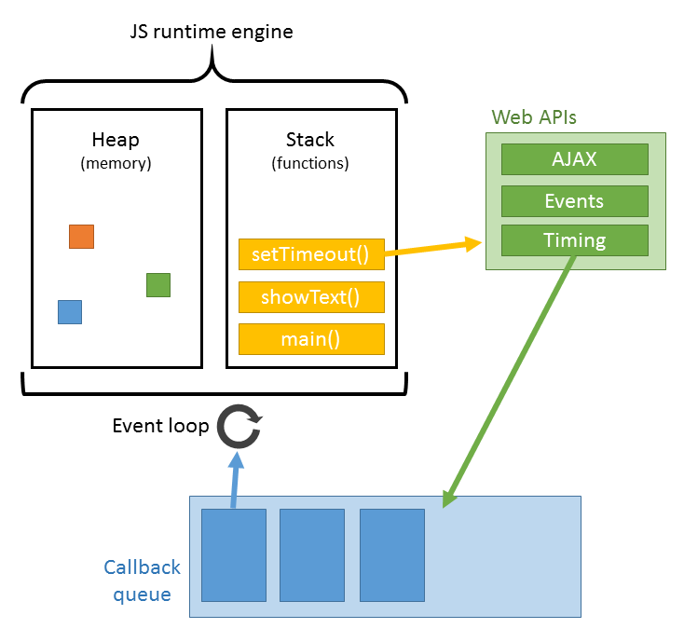
JS: I’m an integral part of Browser working
Me and my other 3 colleagues:
JavaScript Engine:
Call-stack
Heap
Event Loop:
Async Execution
Web-APIs:
Location
WebRTC
DOM APIs
Callback queue
Methods

Slide 12
Me: Wait a sec, if there’s only 1 call-stack, how can you handle multiple things? Multiple threads??
JS: I don’t have them, I work in single-threaded fashion..
Me : Oh poor soul!! :-( ...but wait, how are you able to handle many things at a time then??
JS: I’ve my Event-loop, It makes me Async.. ;-)
It keeps long-lasting jobs like
Network requests
SetTimeout., etc
in the background to make me always available for new tasks and works.
I literally don’t wait for anyone, and I’m available for everyone!

Slide 13
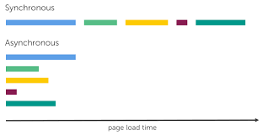
Sync vs Async

Slide 14
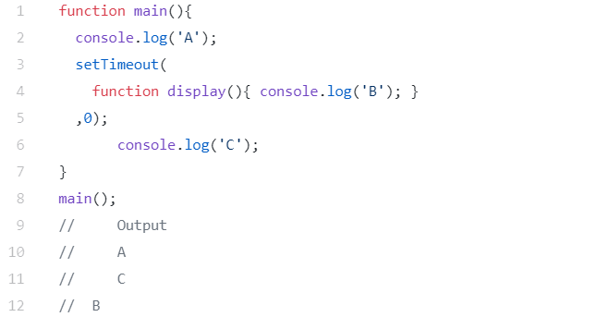
ME: What is Async?? And How is it different from normal?
JS: See the difference of my execution compared to the normal one...
Expected Output:
A
B //after given ms
C
Actual Output:
A
C
B //after given ms

Slide 15
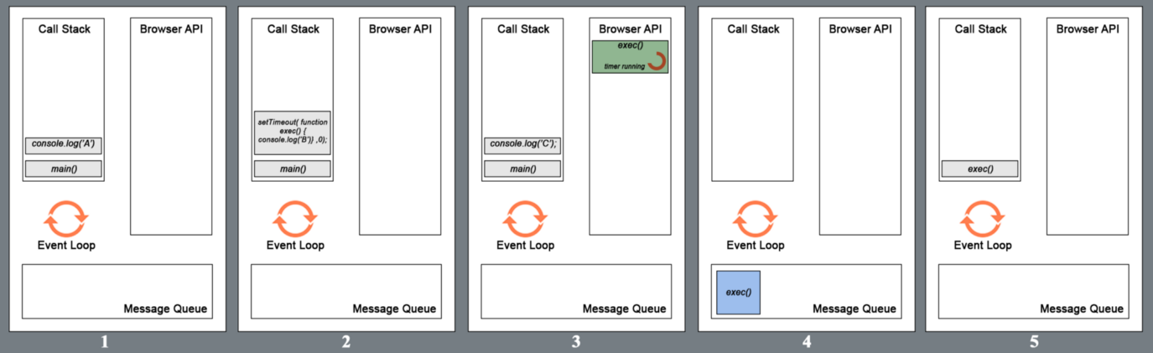

JS: You would love me if you know how I do stuff ;-)
Me: You are weird,.. Good but still weird.. How do you be this?

Slide 16
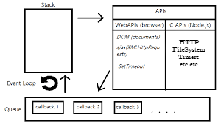
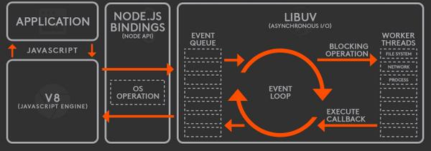
Me: That’s actually pretty awesome!, do you work the same on server-side? As in Node.js?
JS: I work in the same way, but with few differences. I use C/C++ APIs instead of Browser’s
JS: libuv library takes care of my eventloop execution in Node

Slide 17
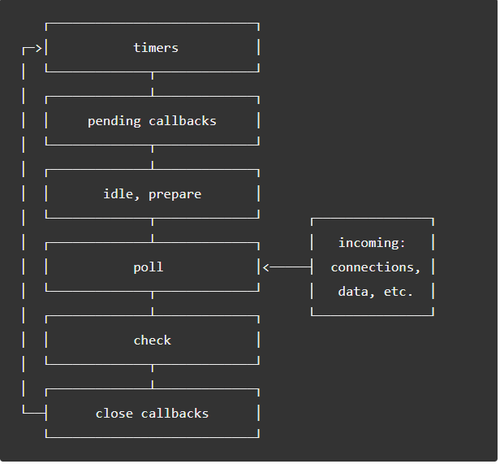
JS: My event-loop works in phases in Node.
Timers: callbacks scheduled by setTimeout() and setInterval() Pending callbacks: Executes I/O callbacks deferred to the next loop iteration idle, prepare: only used internally. poll: - retrieve new I/O events; - execute I/O related callbacks - node will block the close callbacks, one’s scheduled by timers, and setImmediate() check: setImmediate() callbacks are invoked here. close callbacks: some close callbacks, e.g. socket.on('close', ...).

Slide 18
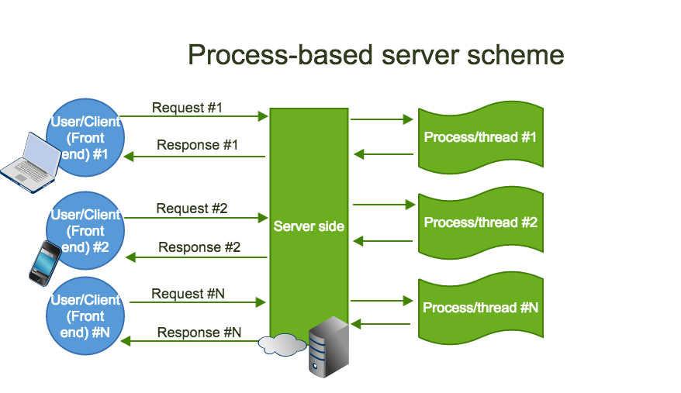
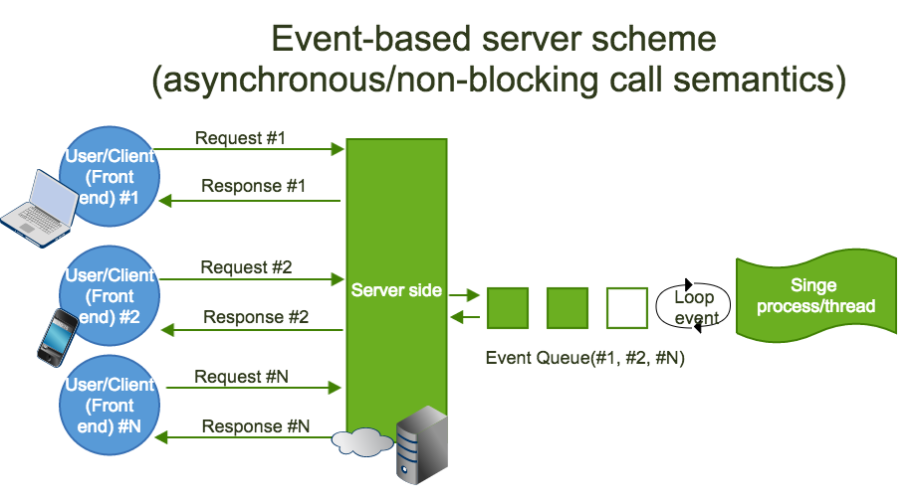
Processed based(Apache) vs Event based(Node)

Slide 19
Scaling
JS: Sure, I’ll let you know some secrets for Node’s best performance
Me: That’s really a great talk with you, can I know some performance hacks with you?
Types :
Cloning
Forking processes manually(child_process lib in Node)
clustering(cluster lib in Node)
Decomposing
microservices
Splitting
database-partitioning
Bonus Tip: Use streams of Node when dealing with huge files/Objects

Slide 20
Thank you
JS and Me
(tetali.chaitanya@gmail.com) (+919092658797)
Any Queries?

